Slide 1

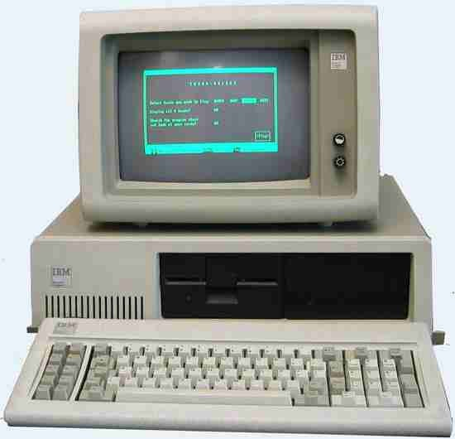
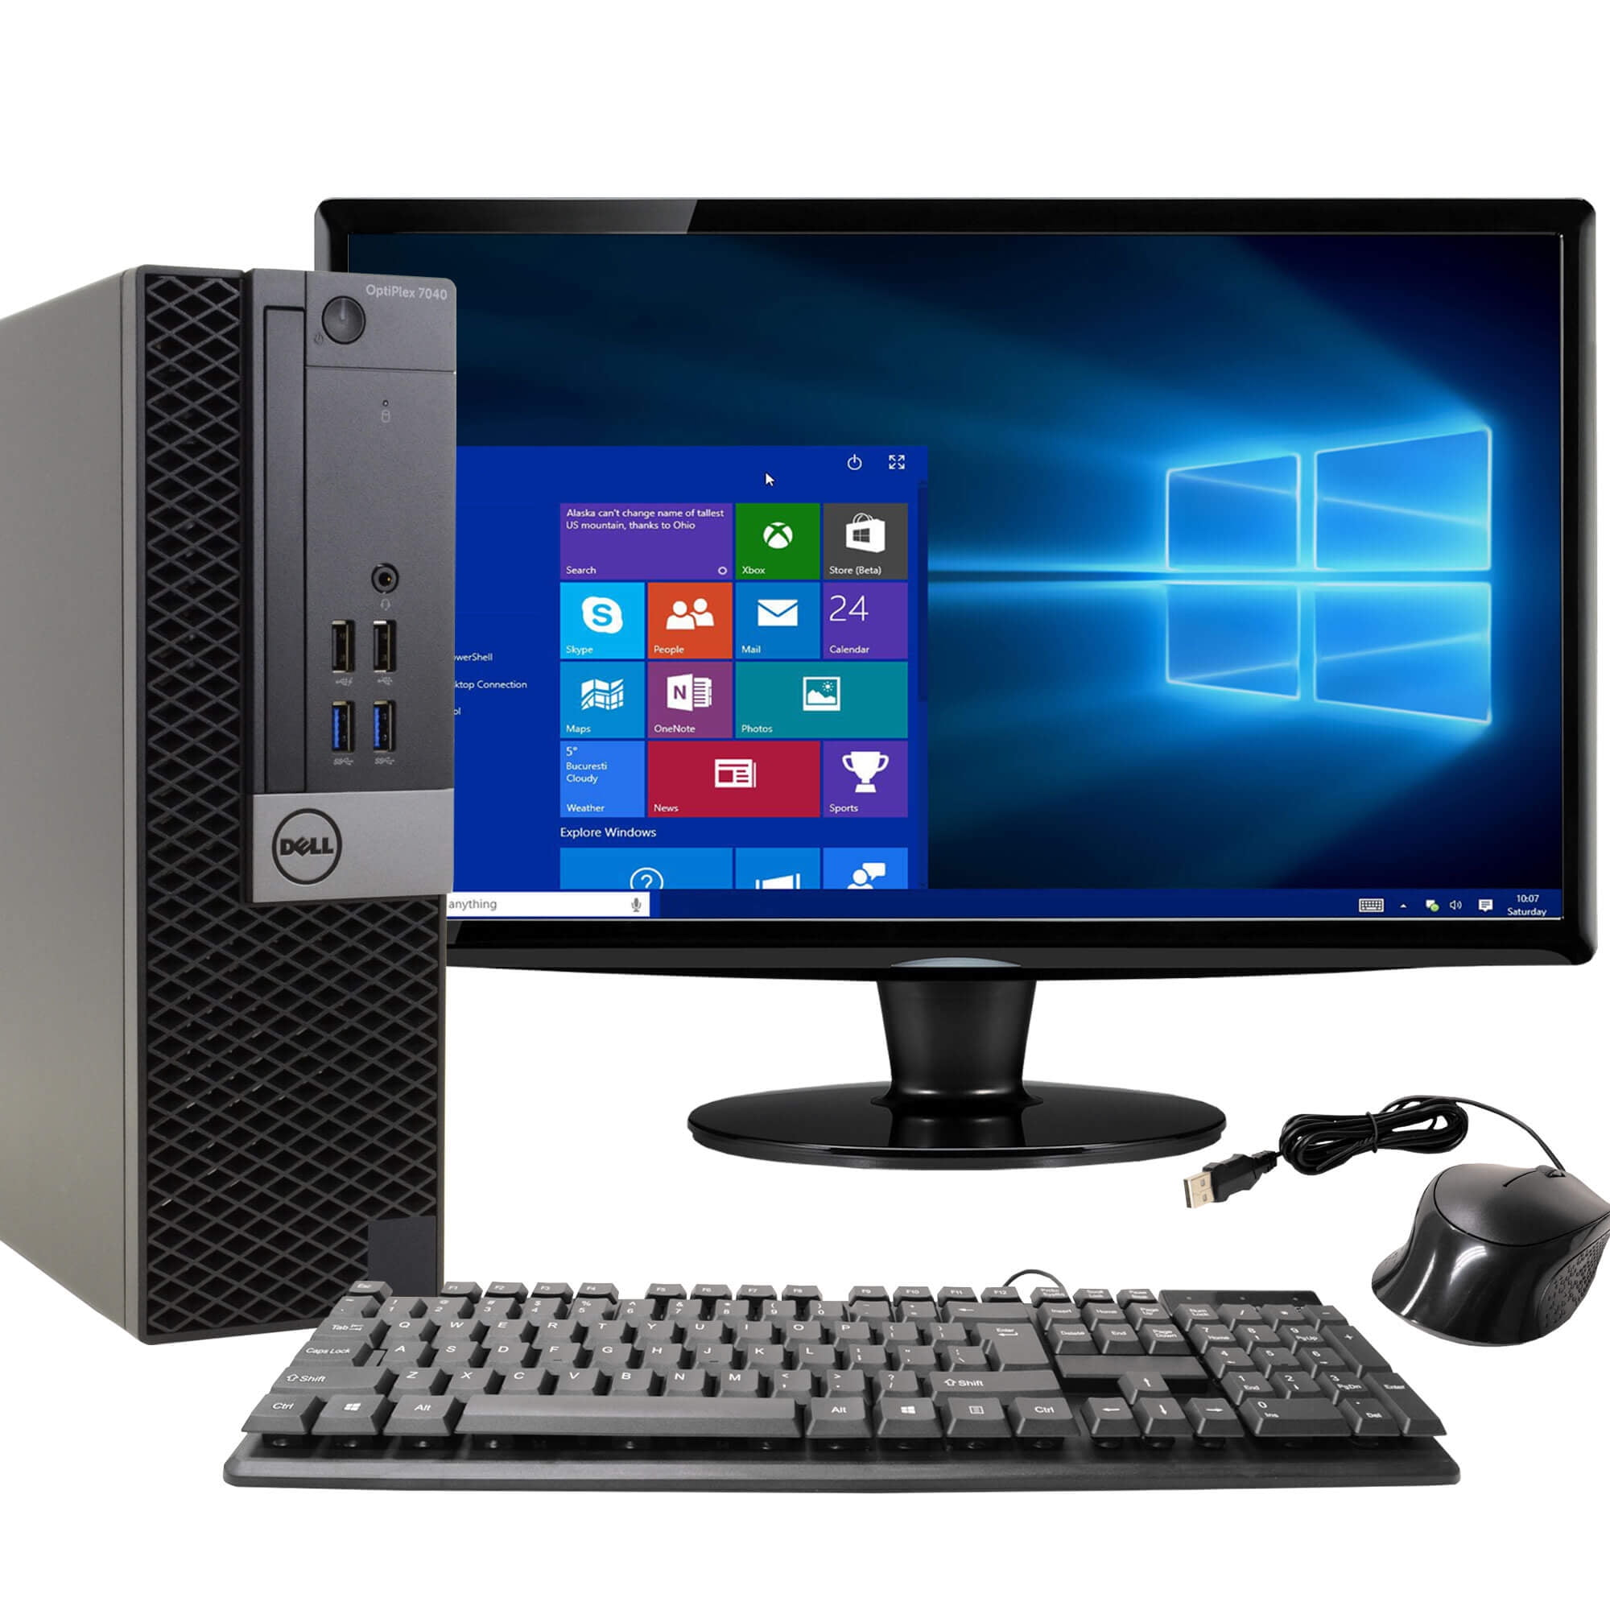
Course overview Exploring a desktop computer

Slide 2
Units
Unit 1 Exploring the world of computing
Unit 2 Becoming an informed user
Unit 3 Algorithmic thinking and abstraction
Unit 4 The design of computer systems
Unit 5 The world of computing perspectives

Slide 3
Schedule of Unit 1
Class Schedule:
Course overview, Exploring a desktop computer (Week 1, Class 1)
History of computing (Week 1, Class 2)
Exploring computing devices: Smartphones, Embedded systems in appliances, etc. (Week 2, Class 1)
Quiz 1, Simulating Arduino circuits in Tinkercad (Week 2, Class 2)
Project work (Week 3, Both sessions)

Slide 4
By the end of this session
Recognize salient features of computing devices and systems and describe them.
Identify external and internal hardware and software components of a desktop computer.
Describe the booting process and role of the operating system.
Perform basic desktop operations (file handling, checking system info).

Slide 5
What Is a Desktop Computer?

Slide 6
What Is a Desktop Computer?
The word computer comes from the word “compute”, which means, “to calculate”
Thereby, a computer is an electronic device that can perform arithmetic operations at high speed

Slide 7
What Is a Desktop Computer?
A desktop computer is a personal computer designed for regular use at a single location—typically on or under a desk—rather than being portable like a laptop or tablet.
It is composed of multiple separate parts, including a central processing unit (CPU), monitor, keyboard, and mouse.

Slide 8
What Is a Desktop Computer?
Feature | Desktop | Laptop | Tablet
Portability | No | Yes | High
Performance | High | Medium–High | Limited
Upgradeability | Easy | Limited | Not possible
Screen Size | Large | Medium | Small

Slide 9
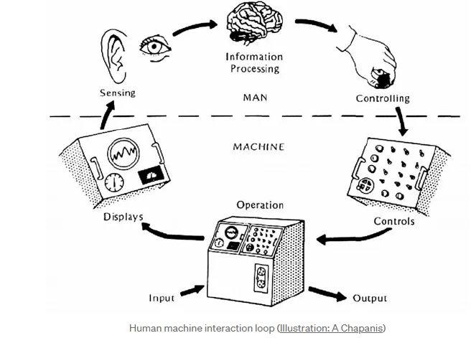
What Is a Desktop Computer?
Notes:
Human Operating Systems. The interface between your mind, your… | by David A. Palmer | The New Mindscape | Medium

Slide 10
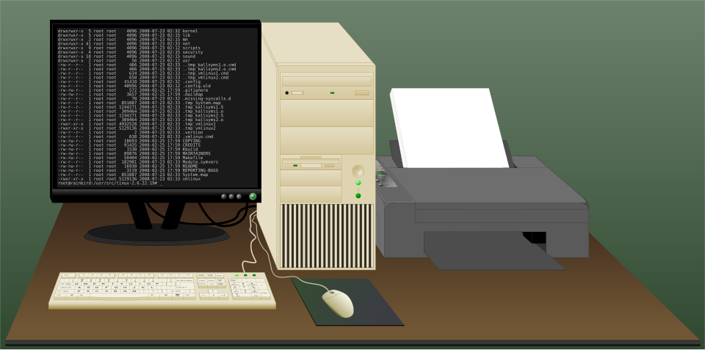
External Components

Slide 11
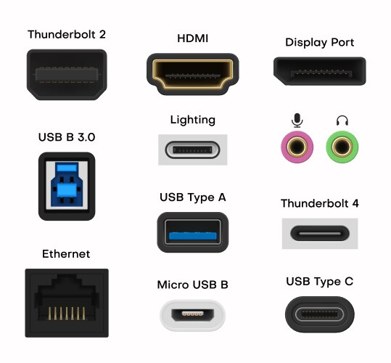
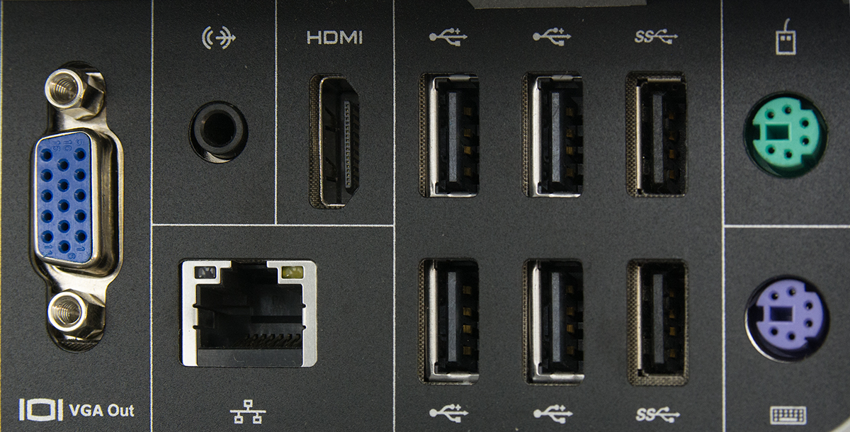
External Components - Ports

Slide 12
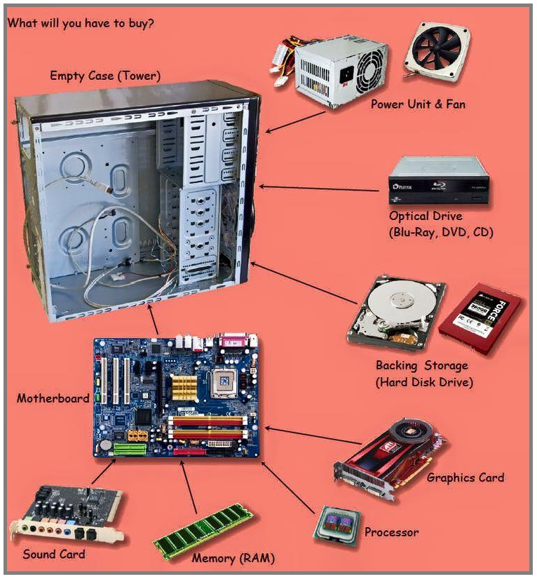
Internal Components

Slide 13
Component Functions
Component | Description | Function
Motherboard | Main circuit board | Connects all internal components and allows communication between them
Central Processing Unit (CPU) | The "brain" of the computer | Performs calculations and executes instructions
Random Access Memory (RAM) | Temporary memory | Stores data and instructions currently in use for fast access
Hard Disk Drive (HDD) / Solid State Drive (SSD) | Long-term storage | Stores operating system, applications, and files
Power Supply Unit (PSU) | Converts electrical power | Supplies power to all internal components
Monitor | Visual output device | Displays text, images, and videos generated by the computer
Keyboard | Input device with keys | Used to enter text and commands

Slide 14
Component Functions
Component | Description | Function
Mouse | Pointing device | Used to interact with graphical elements on screen
Graphics Processing Unit (GPU) | Optional separate chip or card | Renders images, videos, and animations (useful for gaming and design)
Optical Drive (CD/DVD) | Reads/writes CDs or DVDs (less common now) | Allows reading and writing of discs
Cooling Fan / Heat Sink | Temperature control components | Keeps CPU and other parts cool to prevent overheating
Speakers | Audio output devices | Play sound output from the computer
Network Interface Card (NIC) | Built-in or external card | Enables connection to a network (LAN/internet)
USB Ports | Universal connectors | Allow connection of external devices like pen drives, printers, etc.

Slide 15
Working of a Desktop Computer

Slide 16
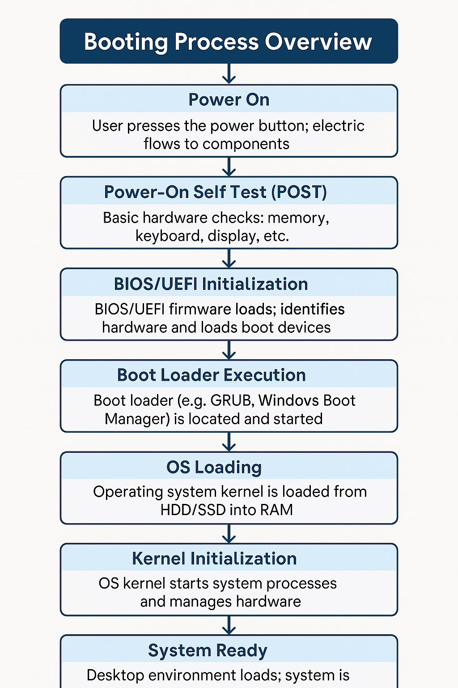
Booting Process Overview

Slide 17

What Is an Operating System?
An Operating System (OS) is the main software that manages all the hardware and software in a computer. It acts like a bridge between the user and the computer hardware.
Examples:
Windows (most desktops)
macOS (Apple computers)
Linux (Ubuntu, Fedora, etc.)
Android/iOS (in smartphones)
Notes:
theatre play

Slide 18
What Is an Operating System?
Function | What it Does | Example
Process Management | Runs and controls programs | You open a browser + Word
Memory Management | Allocates and tracks RAM use | Keeps apps from overwriting each other
File System Management | Organizes data into files and folders | Access your saved documents
Device Management | Controls hardware like printers, mouse, keyboard | Plugging in a USB drive
User Interface (UI) | Allows user to interact with system (GUI/CLI) | Windows desktop, Linux terminal

Slide 19
File System and Drives
A file system is a method used by the Operating System to store, organize, manage, and access files on a storage device (like hard disks, SSDs etc.).
It defines:
How data is named
How it is stored and retrieved
How files are organized (like folders and directories)

Slide 20
File System and Drives
Term | Explanation
File | A collection of data stored under a name (e.g., Word doc, image, video)
Folder (Directory) | A container that holds multiple files or folders
Path | The address of a file/folder (e.g., C:\Users\Yogi\Documents\notes.docx)
Drive | A letter assigned to a storage device (like C:, D:, E:)
Notes:
Uses Organizes files so they are easy to find
Tracks where data is stored on the disk
Manages read/write operations
Controls access (read-only, full access)

Slide 21
Useful System Tools in a Desktop Computer
Tool Name | Purpose
Task Manager | View and manage running apps and processes; monitor CPU, RAM usage
File Explorer / Finder | Browse, organize, copy/move/delete files and folders
Control Panel / Settings | Change system settings: network, display, sound, users, updates
Command Prompt / Terminal | Run text-based commands for advanced operations

Slide 22
Basic Operations & Maintenance

Slide 23
Basic Desktop Operations
Create/delete folders
Organizing folders Demo
Use keyboard shortcuts (Ctrl+C, Ctrl+V, etc.)
Check system info (RAM, processor)
Running setup (.exe) - Install options and safety tips - Uninstalling via Control Panel
Restarting frozen systems - Antivirus and updates - Cleaning keyboard/screen and safe shutdown

Slide 24
Thank You!

